Slide 1

Gradient descent and linear regression

Slide 2
Optimization

Slide 3
This week’s goals
How to use gradient descent algorithm?
What is linear regression and how to train it?
Which conclusions we may draw using the regression?

Slide 4
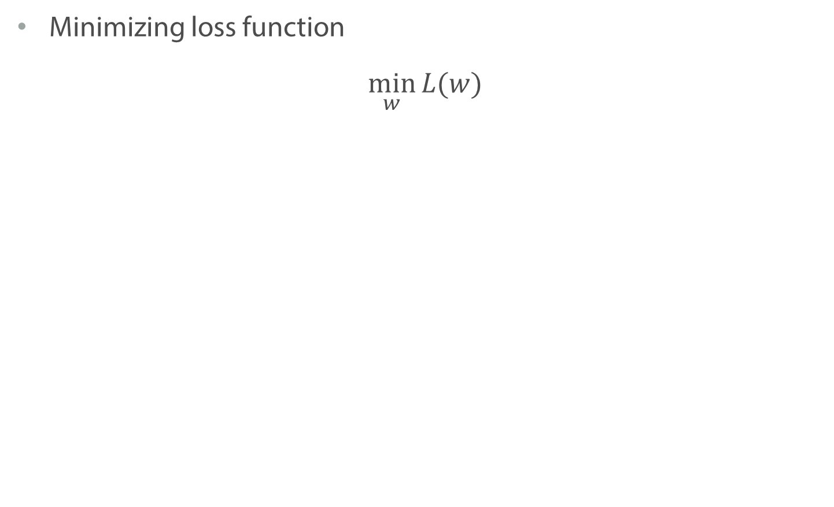
Loss minimization
Minimizing loss function
$$\min_{w}{L(w)}$$

Slide 5
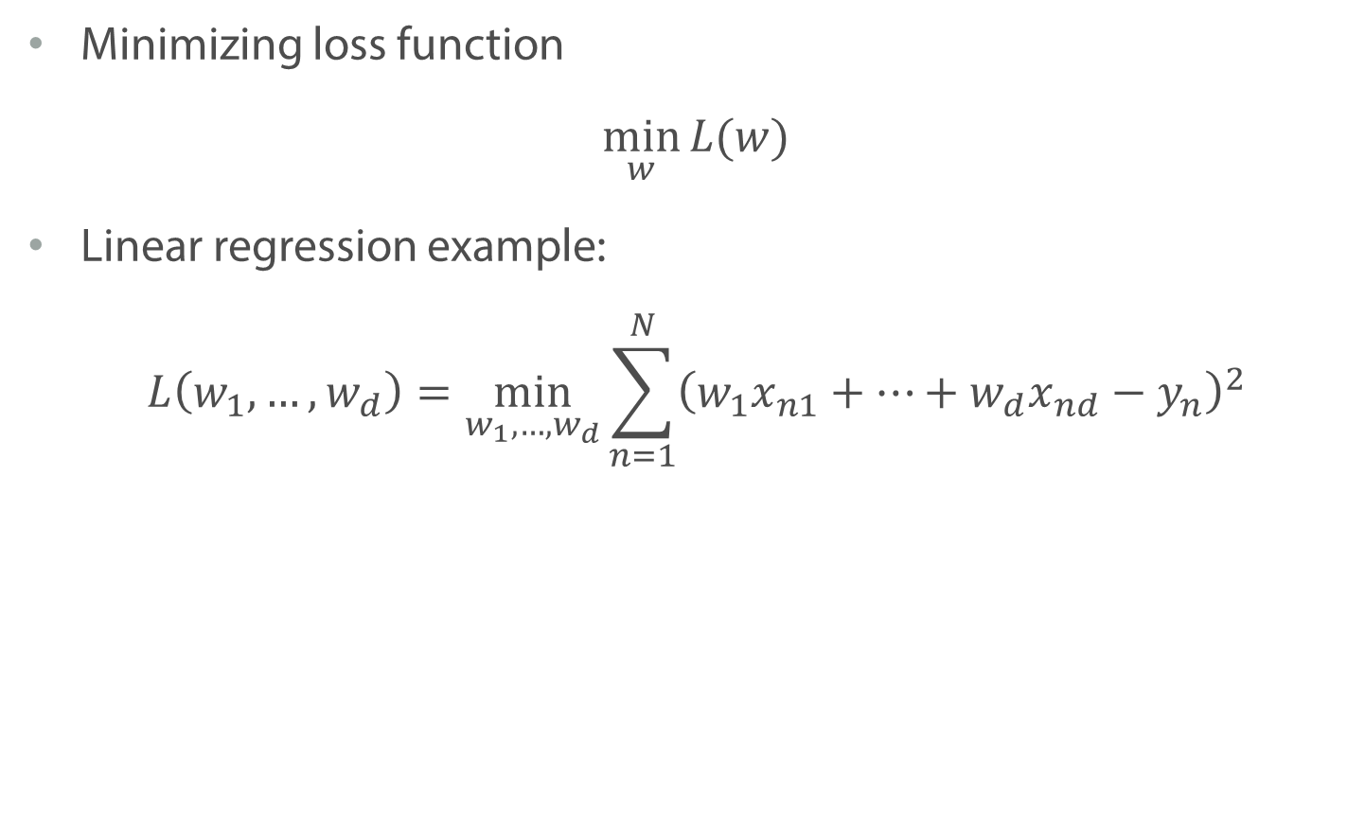
Loss minimization
Minimizing loss function
$$\min_{w}{L(w)}$$
Linear regression example:
$$L\left(w_{1},…, w_{d}\right)=\min_{w_{1},…{,w}_{d}}\sum_{n=1}^{N}{{\left(w_{1}x_{n1}+…+w_{d}x_{nd}−y_{n}\right)}^{2}}$$

Slide 6
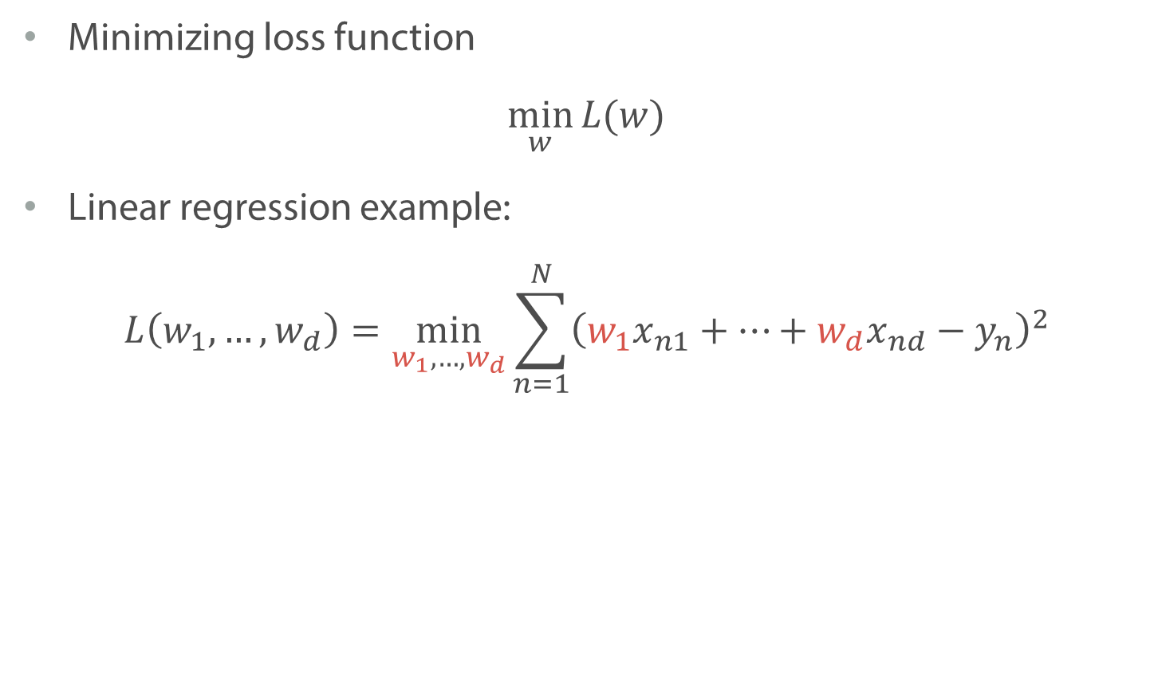
Loss minimization
Minimizing loss function
$$\min_{w}{L(w)}$$
Linear regression example:
$$L\left(w_{1},…, w_{d}\right)=\min_{w_{1},…{,w}_{d}}\sum_{n=1}^{N}{{\left(w_{1}x_{n1}+…+w_{d}x_{nd}−y_{n}\right)}^{2}}$$

Slide 7
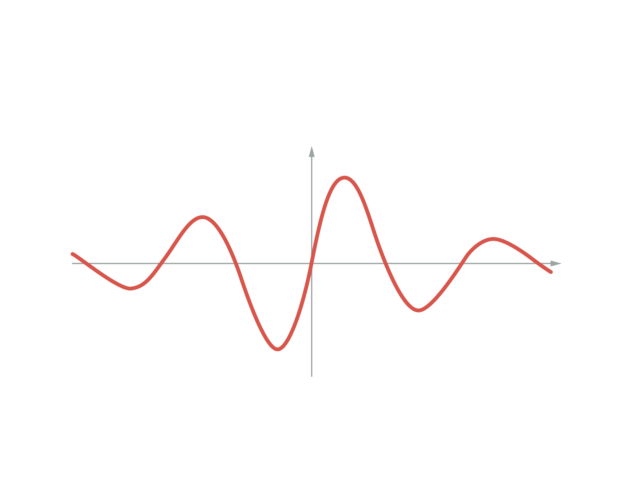
Local and Global Minima
Local Maximum
Global Maximum
Global Minimum
Local Minimum

Slide 8
Convex Functions
Function is convex if the line segment between any two points on the graph lies above or on the graph
Convex function
Non-convex function

Slide 9
Convex Functions
Strictly Convex functions have one minima
Convex function
Non-convex function

Slide 10
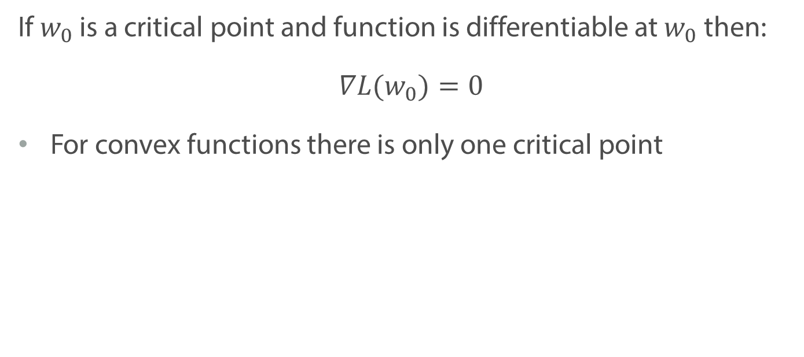
Critical Point Condition
If $w_{0}$ is a critical point and function is differentiable at $w_{0}$ then:
$$∇L(w_{0})=0$$
For convex functions there is only one critical point

Slide 11
Gradient and its properties

Slide 12
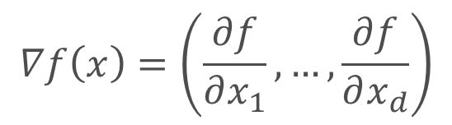
Gradient
Gradient – vector of partial derivatives
$$∇f\left(x\right)=\left(\frac{∂f}{∂x_{1}},…,\frac{∂f}{∂x_{d}}\right)$$

Slide 13
Gradient
Gradient – vector of partial derivatives
There is an important quality!
$$∇f\left(x\right)=\left(\frac{∂f}{∂x_{1}},…,\frac{∂f}{∂x_{d}}\right)$$

Slide 14
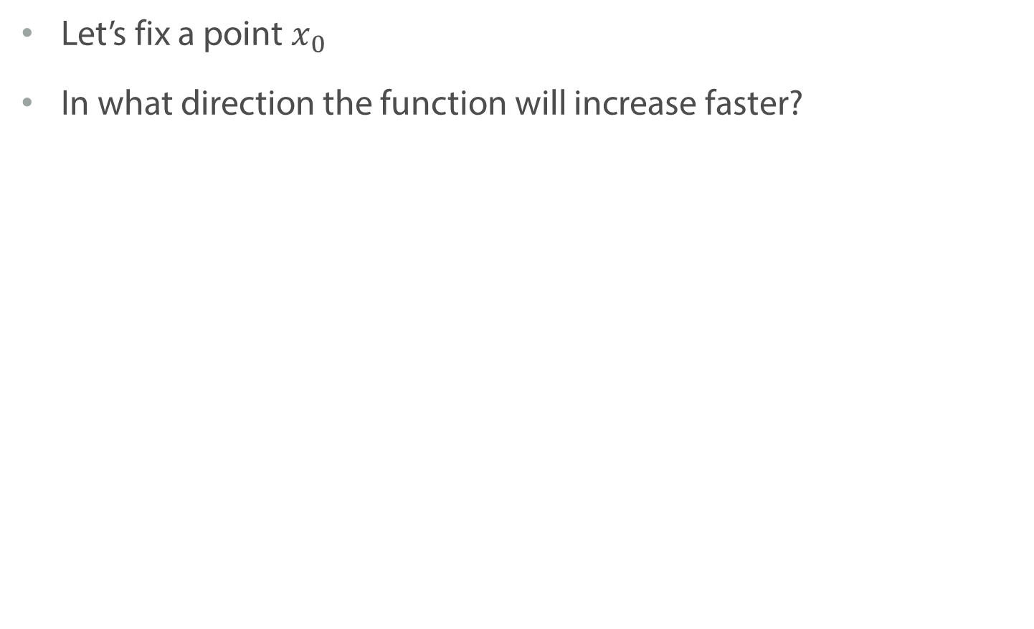
Important quality of a gradient
Let’s fix a point $x_{0}$
In what direction the function will increase faster?
en.wikipedia.org

Slide 15
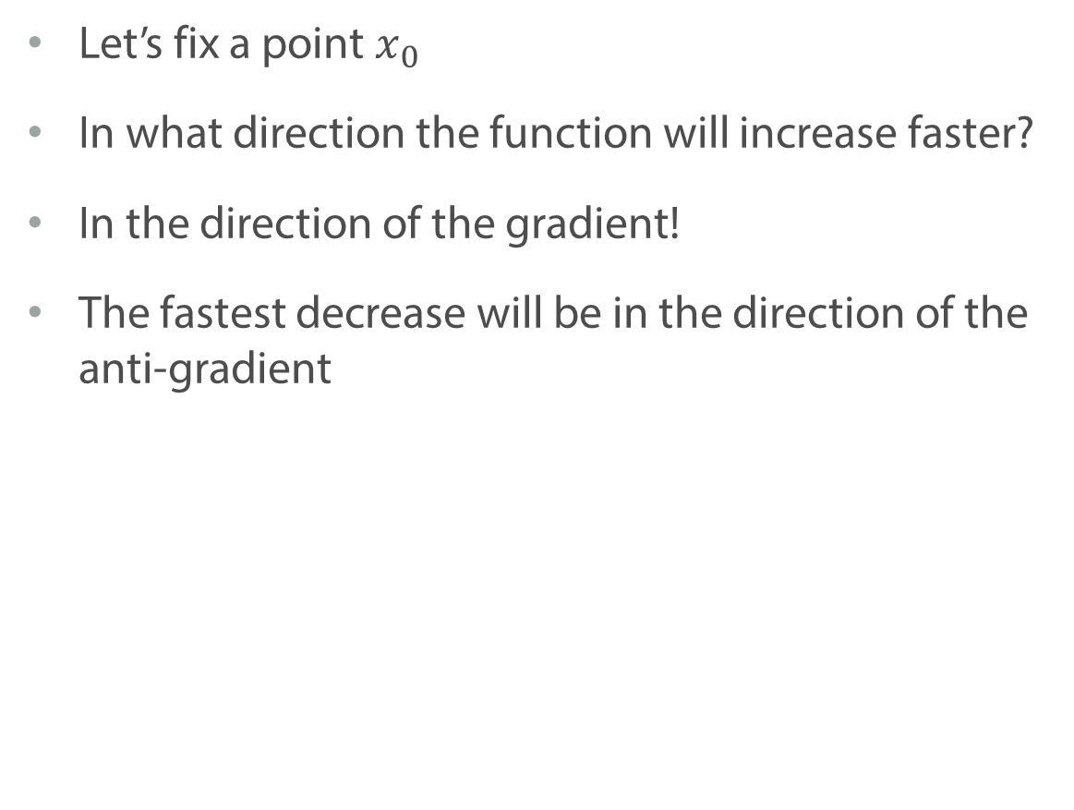
Important quality of a gradient
Let’s fix a point $x_{0}$
In what direction the function will increase faster?
In the direction of the gradient!
The fastest decrease will be in the direction of the anti-gradient
en.wikipedia.org

Slide 16
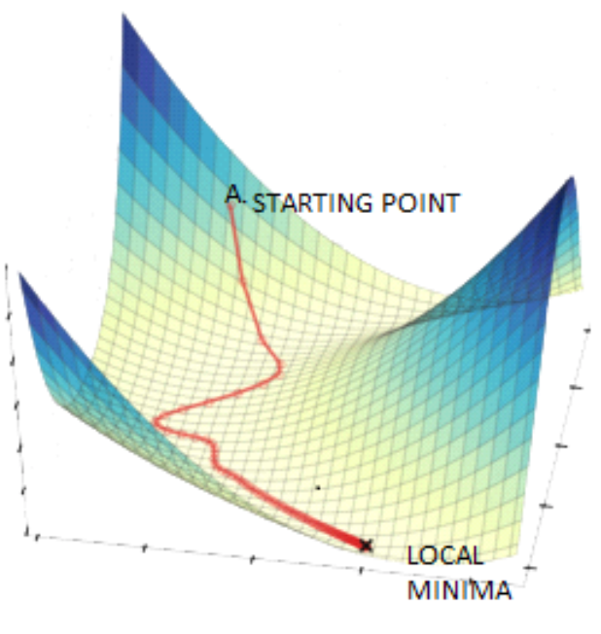
How can we make use of that?
hackerearth.com

Slide 17
Conclusion
We are dealing with optimization in machine learning a lot
Anti-gradient shows the direction of the fastest decrease of a function
We can use it to find minimum of a function

Slide 18
Gradient Descent

Slide 19
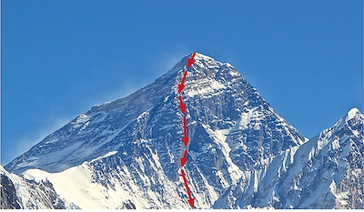
Idea of the gradient descent
codingame.com

Slide 20
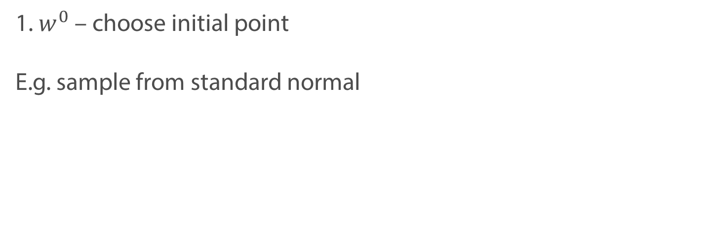

Gradient Descent: first steps
Minimizing loss function
$$\min_{w}{L(w)}$$
1. $w^{0}$ – choose initial point
E.g. sample from standard normal

Slide 21
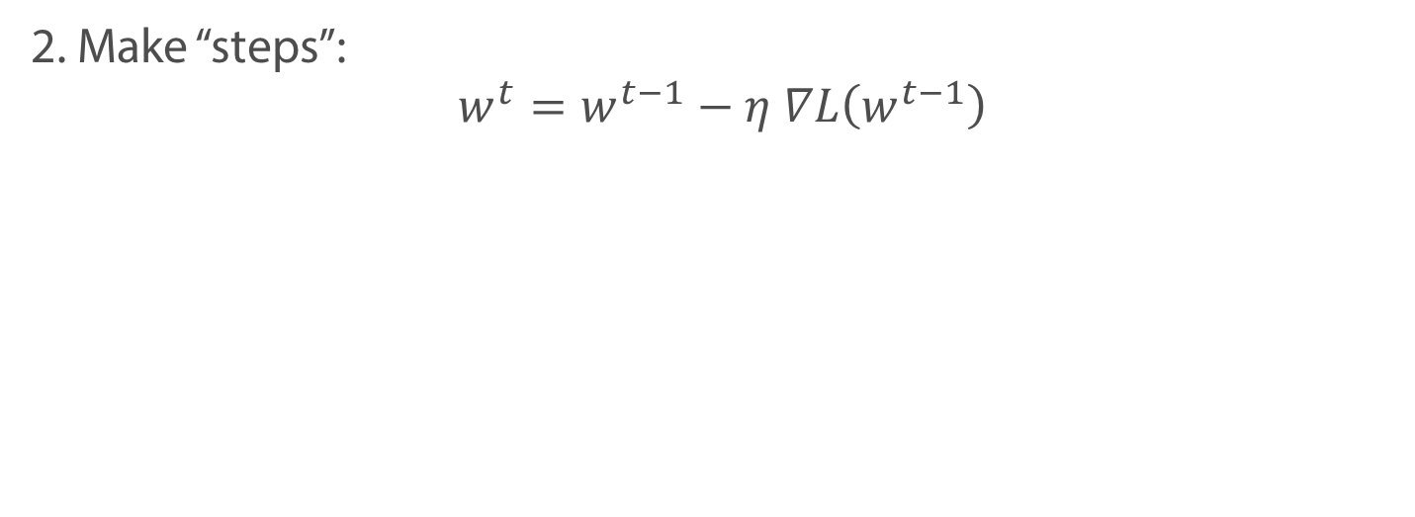
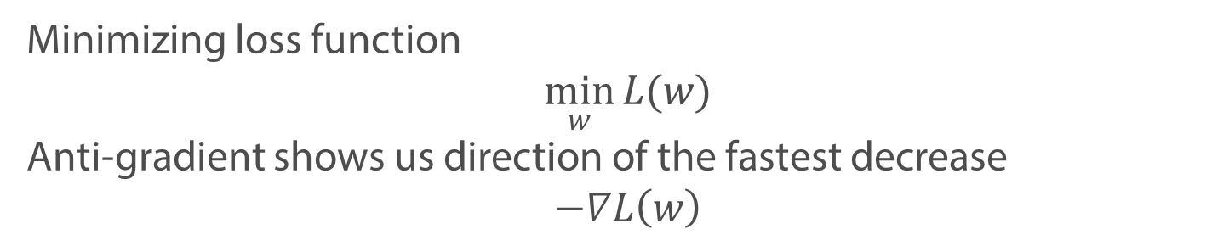
Gradient Descent: first steps
Minimizing loss function
$$\min_{w}{L(w)}$$
Anti-gradient shows us direction of the fastest decrease
$$−∇L\left(w\right)$$
2. Make “steps”:
$$w^{t}=w^{t−1}−η ∇L\left(w^{t−1}\right)$$

Slide 22
Gradient Descent: first steps
Minimizing loss function
$$\min_{w}{L(w)}$$
Anti-gradient shows us direction of the fastest decrease
$$−∇L\left(w\right)$$
2. Make “steps”:
$$w^{t}=w^{t−1}−η ∇L\left(w^{t−1}\right)$$
Step size or Learning rate
New point
Gradient in the previous point

Slide 23


Gradient Descent: convergence
Minimizing loss function
$$\min_{w}{L(w)}$$
3. Stop at step $t$ if:
$$\left\|w^{t}−w^{t−1}\right\|<ε$$
or
$$\left\|∇L\left(w^{t}\right)\right\|<ε$$

Slide 24
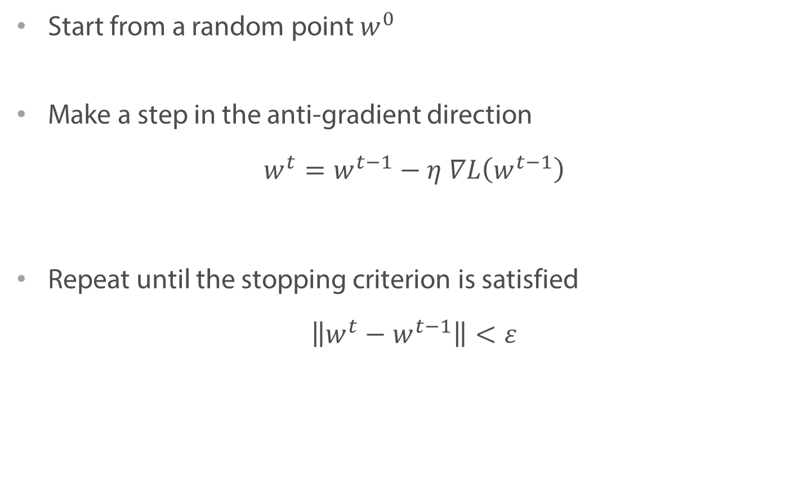
Gradient Descent
Start from a random point $w^{0}$
Make a step in the anti-gradient direction
$$w^{t}=w^{t−1}−η ∇L\left(w^{t−1}\right)$$
Repeat until the stopping criterion is satisfied
$$\left\|w^{t}−w^{t−1}\right\|<ε$$

Slide 25
Gradient Descent

Slide 26
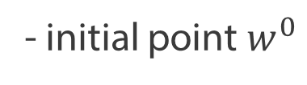
Local and global minima
- initial point $w^{0}$
Local Maximum
Global Maximum
Global Minimum
Local Minimum

Slide 27
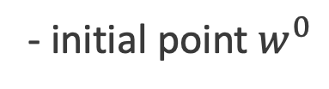
Local and global minima
- initial point $w^{0}$
Local Maximum
Global Maximum
Global Minimum
Local Minimum

Slide 28
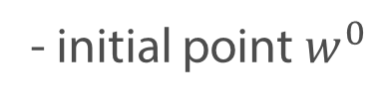
Local and global minima
- initial point $w^{0}$
Local Maximum
Global Maximum
Global Minimum
Local Minimum

Slide 29
Local and global minima
Gradient descend finds a local minima
Possible solutions:
Multi-start – try different initial points
Learning rate annealing

Slide 30
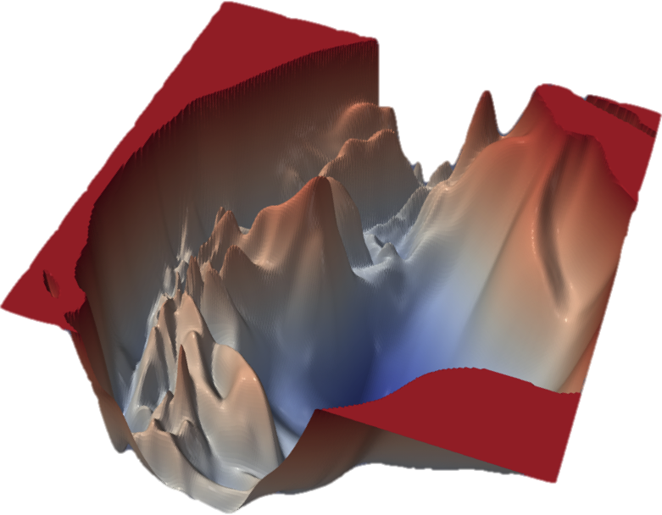
Local and global minima
cs.umd.edu

Slide 31
Modifications of Gradient Descent

Slide 32
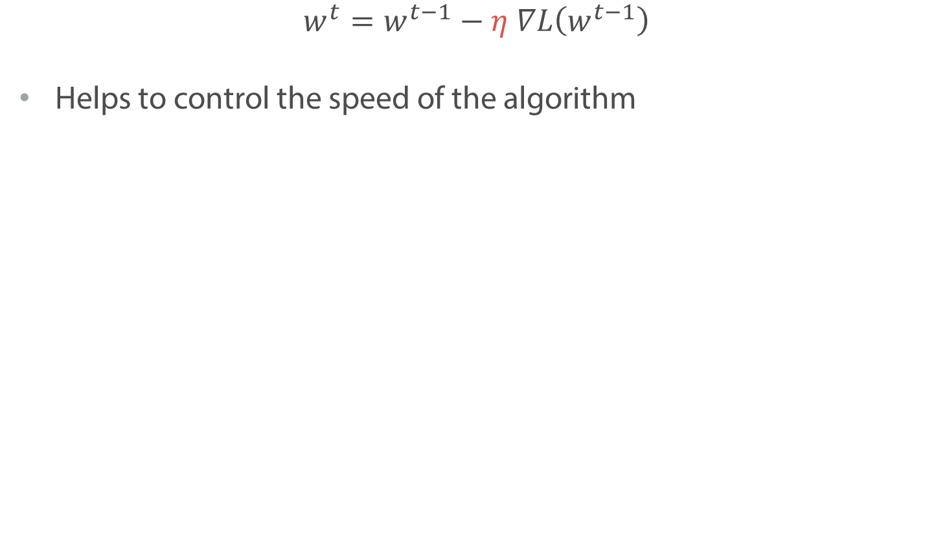
Learning rate
$$w^{t}=w^{t−1}−η ∇L\left(w^{t−1}\right)$$
Helps to control the speed of the algorithm

Slide 33
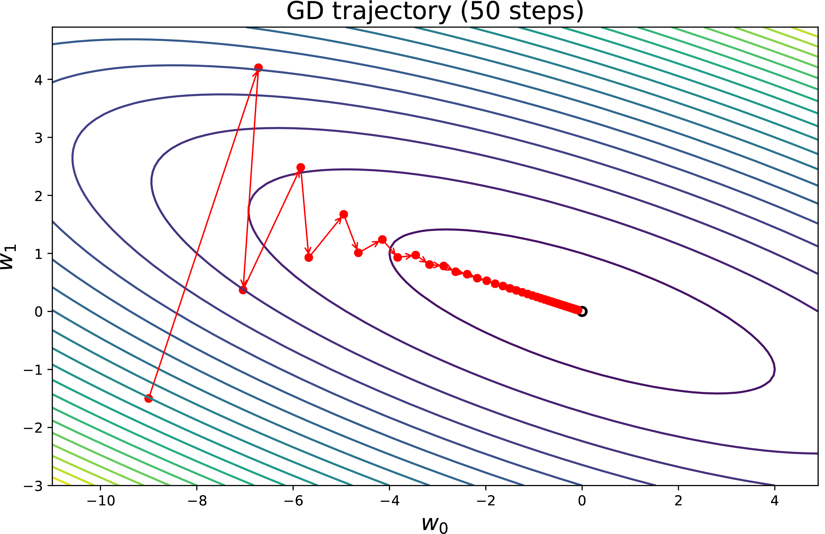
Learning rate

Slide 34
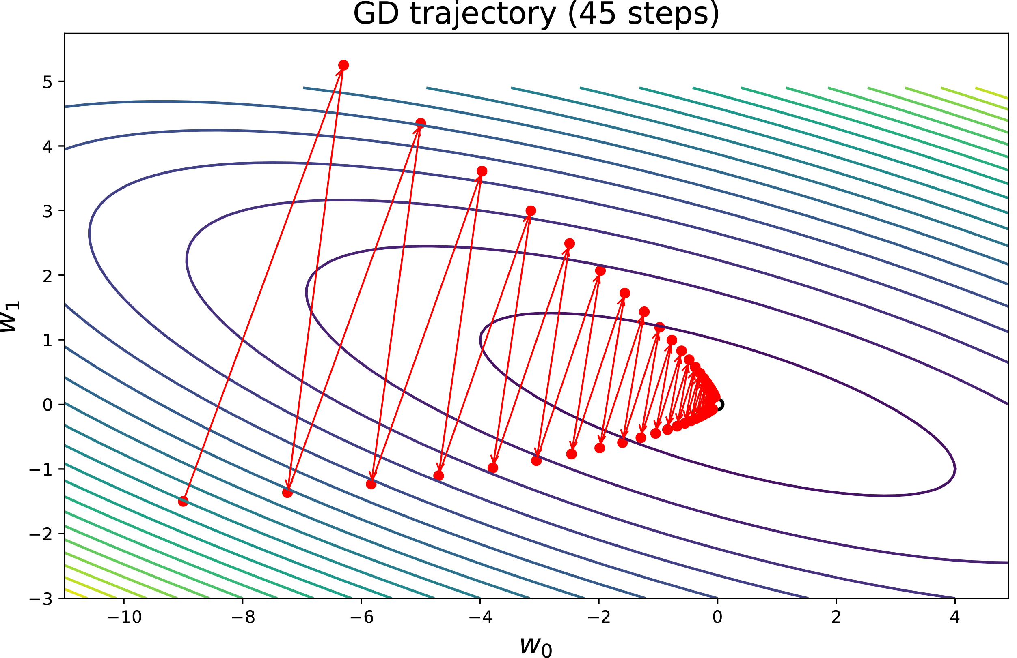
Learning rate

Slide 35
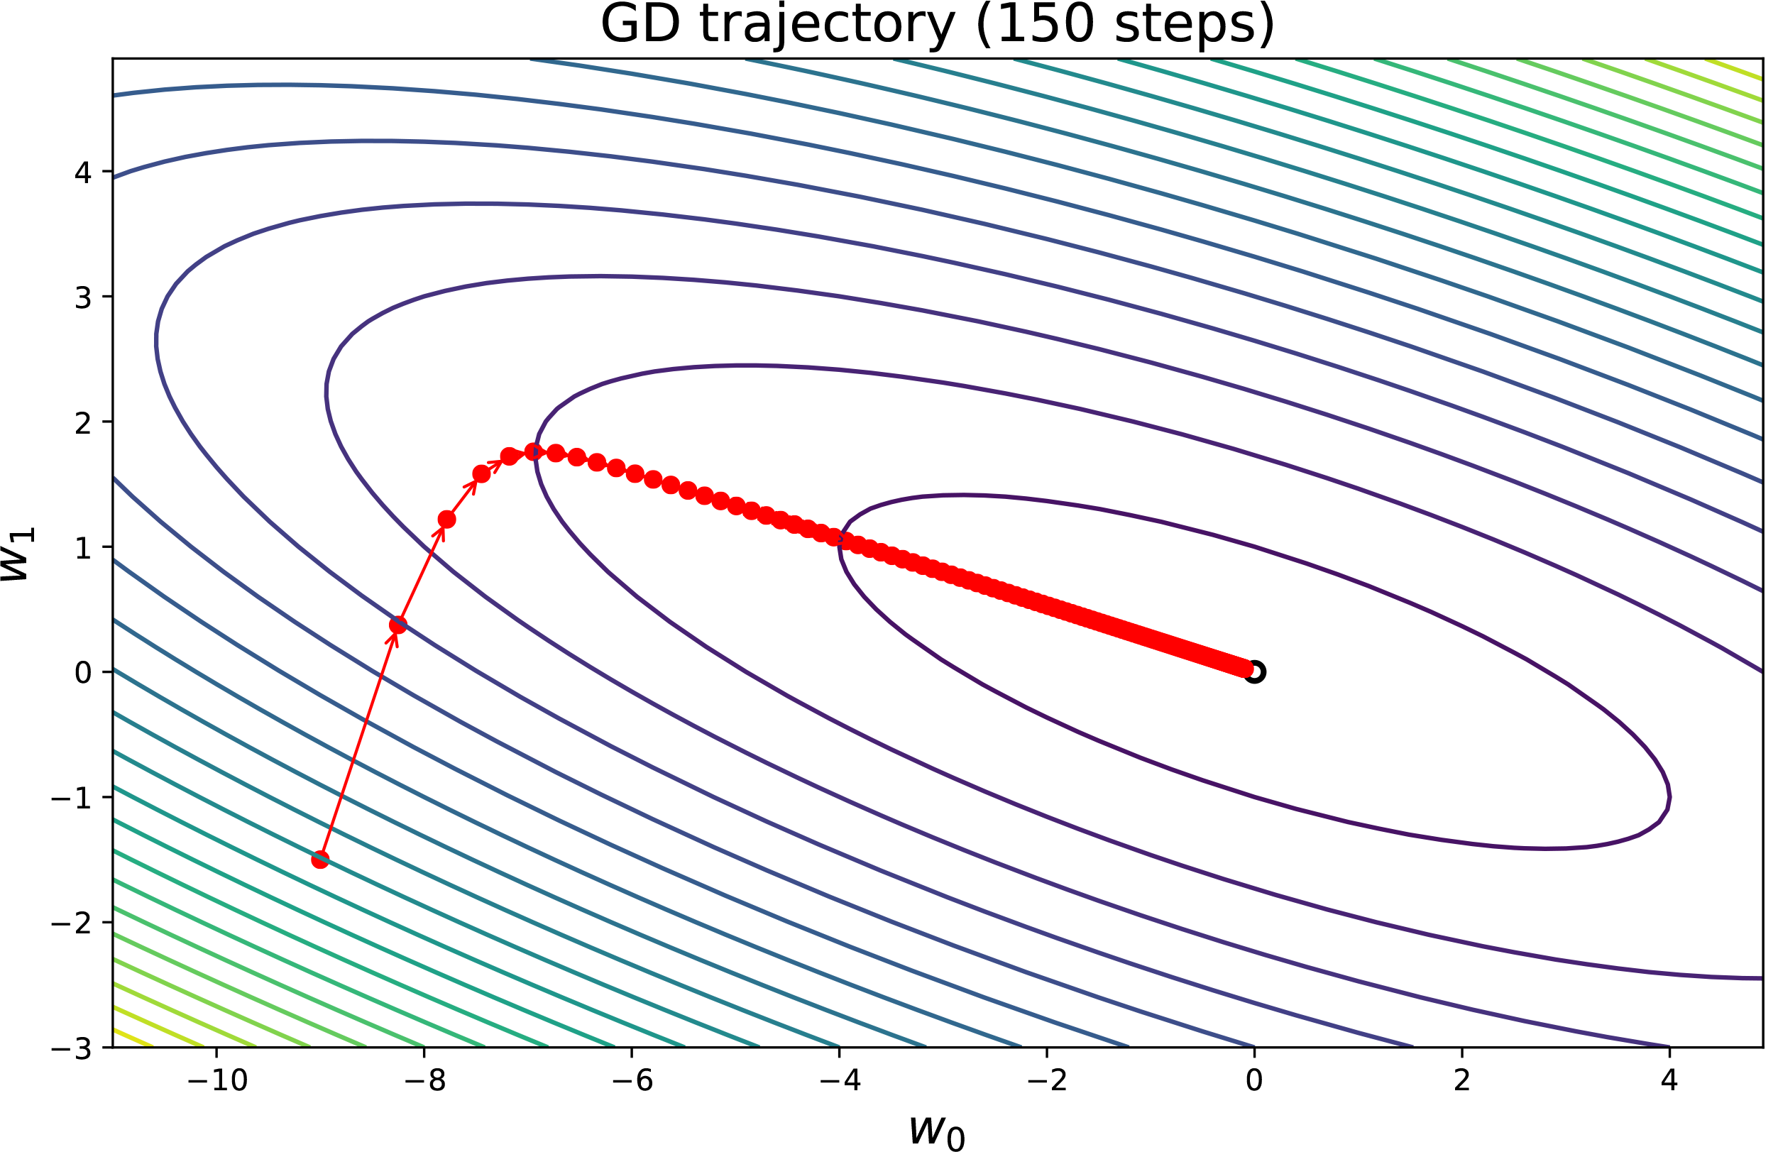
Learning rate

Slide 36
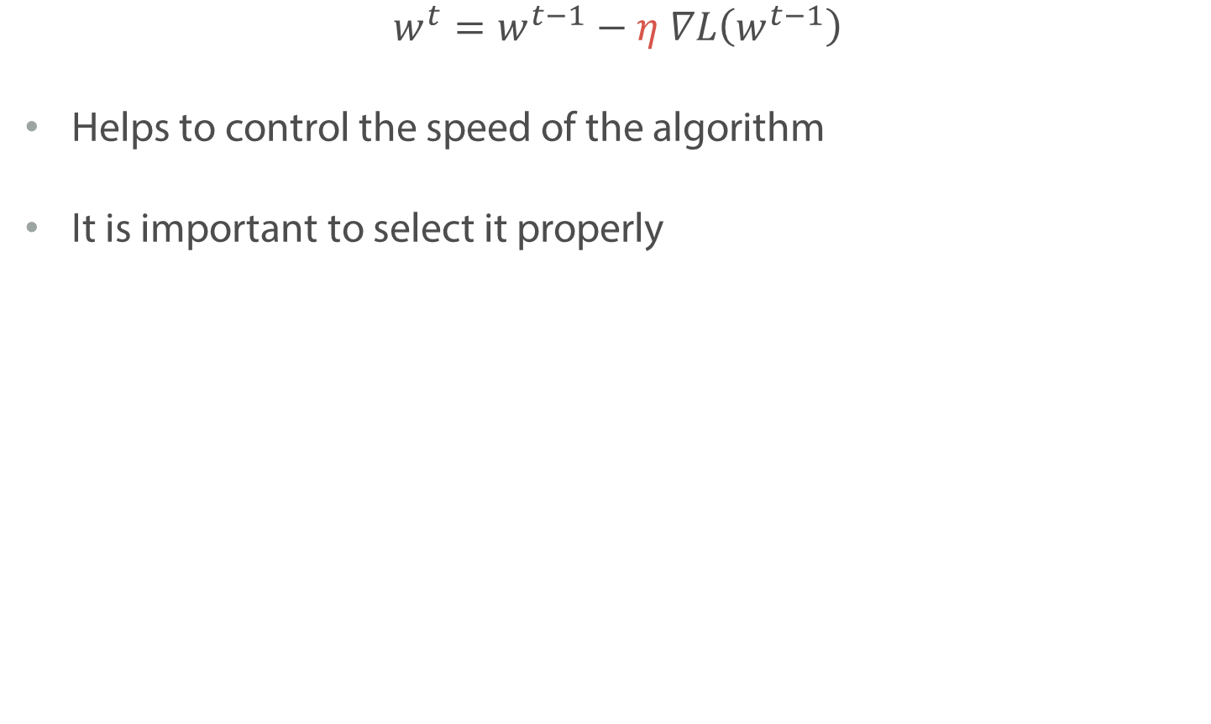
Learning rate
$$w^{t}=w^{t−1}−η ∇L\left(w^{t−1}\right)$$
Helps to control the speed of the algorithm
It is important to select it properly

Slide 37
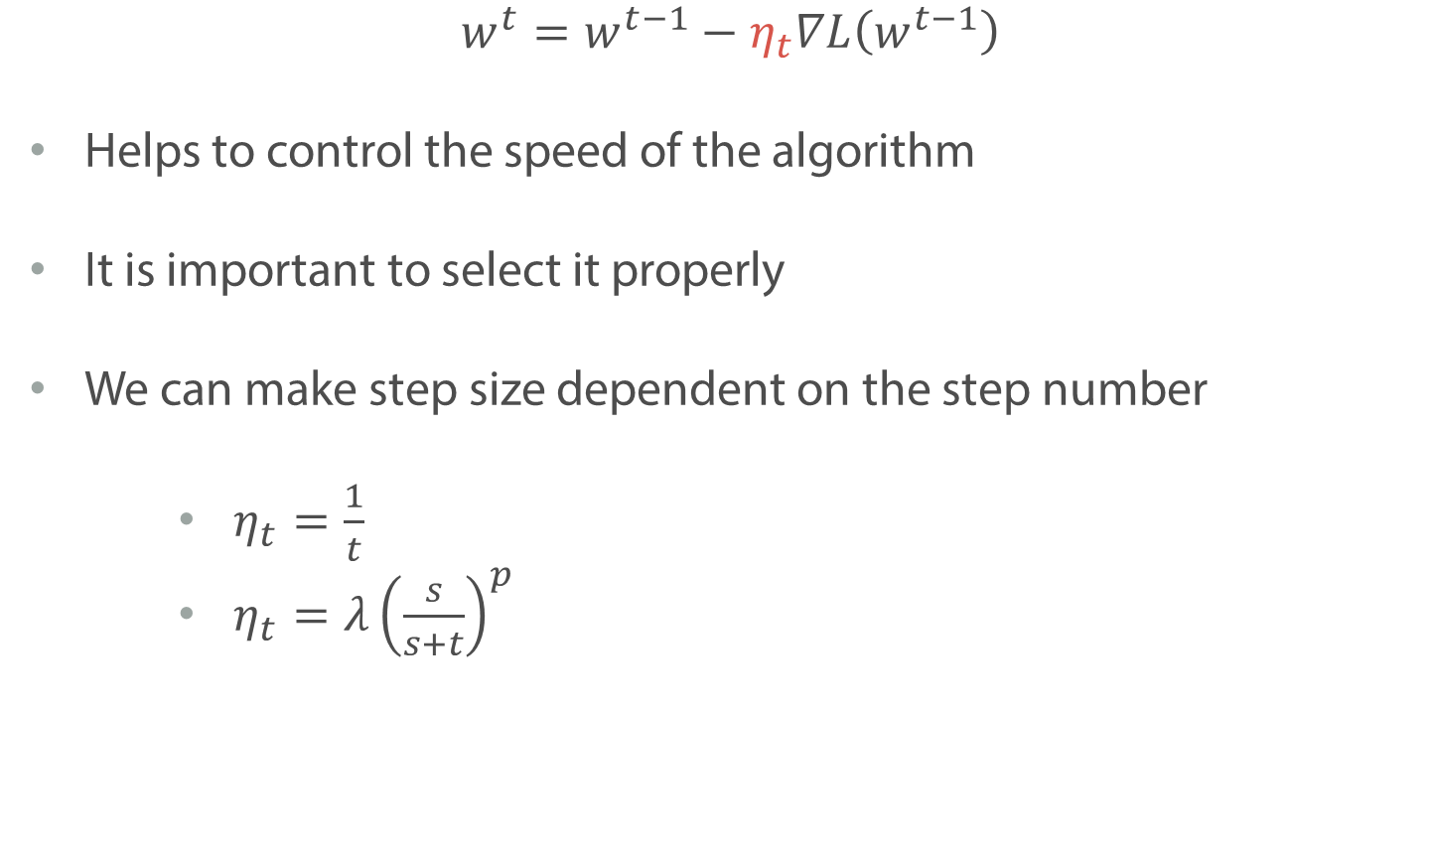
Learning rate
$$w^{t}=w^{t−1}−η_{t}∇L\left(w^{t−1}\right)$$
Helps to control the speed of the algorithm
It is important to select it properly
We can make step size dependent on the step number
$η_{t}=\frac{1}{t}$
$η_{t}=λ{\left(\frac{s}{s+t}\right)}^{p}$

Slide 38
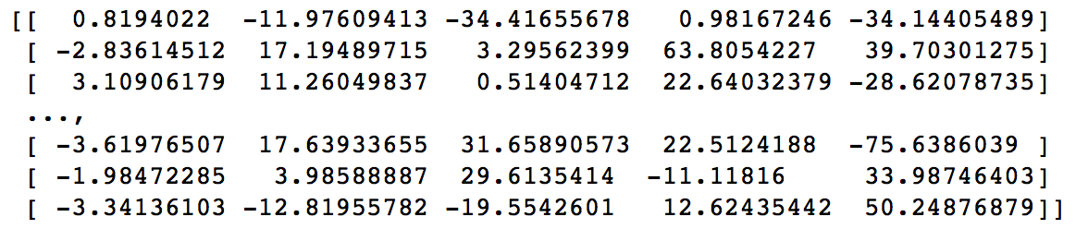
Features scaling

Slide 39
Features scaling

Slide 40
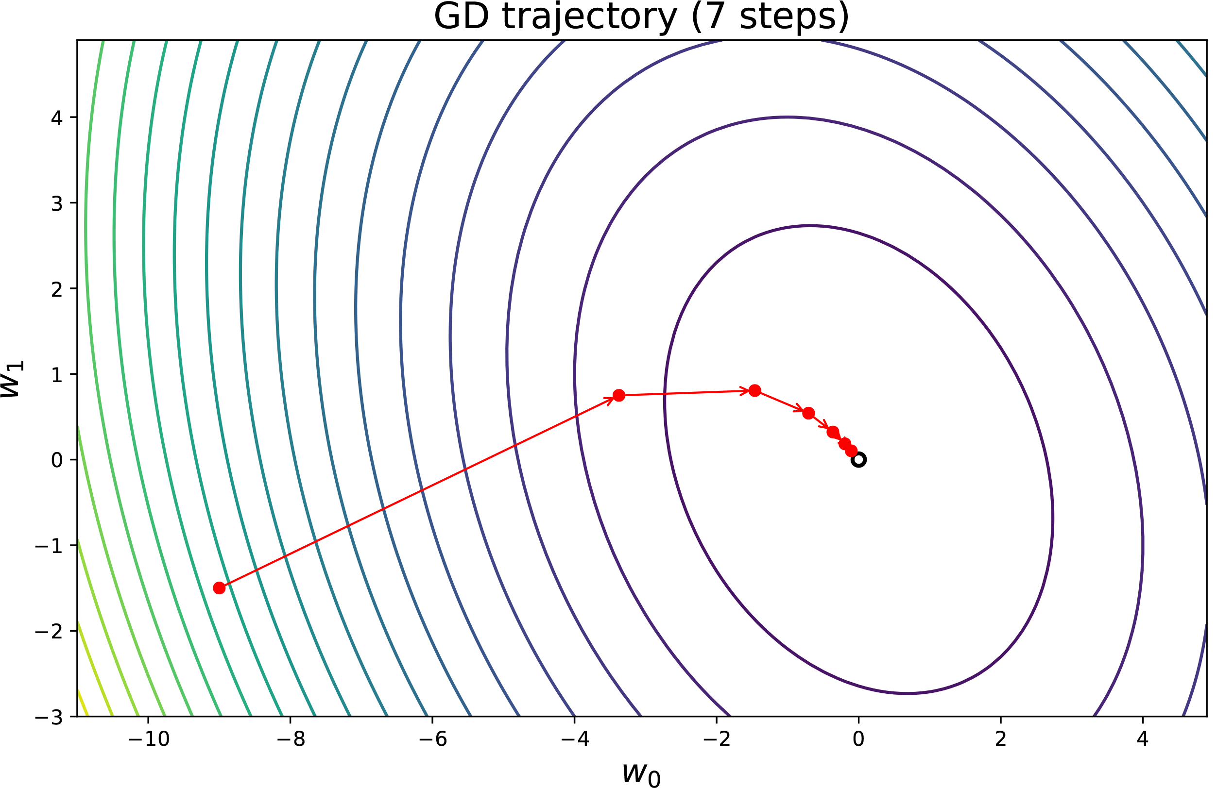
Features scaling

Slide 41
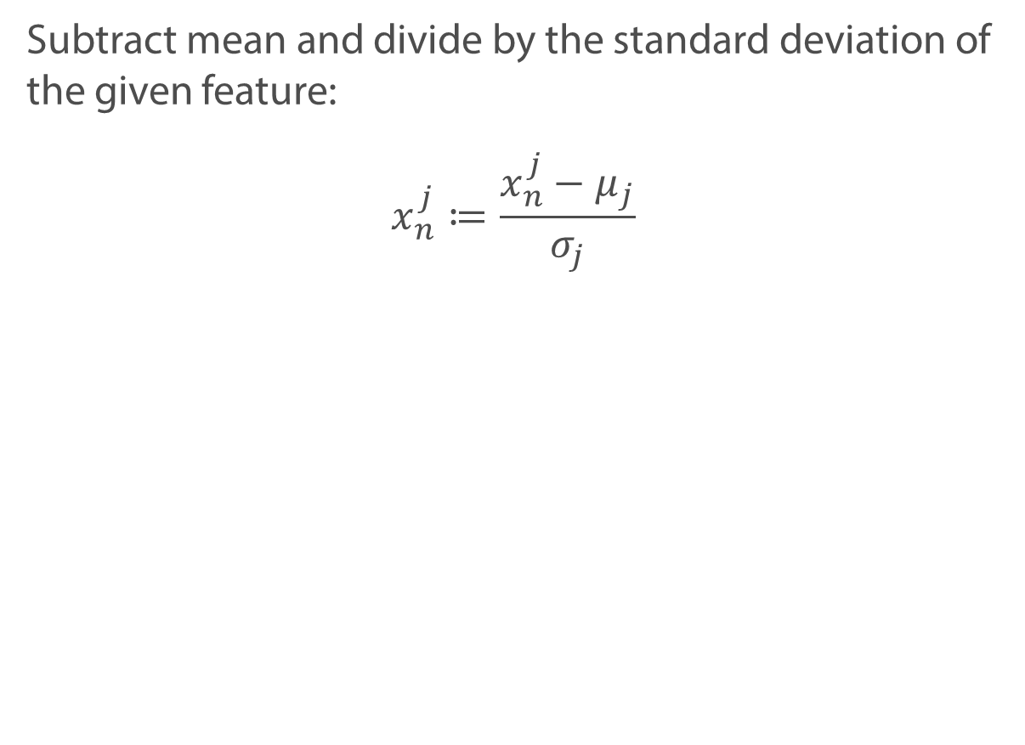
Features scaling
Subtract mean and divide by the standard deviation of the given feature:
$$x_{n}^{j}≔\frac{x_{n}^{j}−μ_{j}}{σ_{j}}$$

Slide 42
Other modifications
Stochastic gradient descend
Momentum: new direction is only partly determined by the gradient
AdaGrad and RMSprop: even smarter way to choose learning rate

Slide 43
Summary
Gradient descend is an optimization algorithm, which finds local minima of a function
It is important to select learning rate (step size) properly
Feature scaling leads to better convergence

Slide 44
Linear regression

Slide 45
Linear Regression

Slide 46
Linear Regression

Slide 47
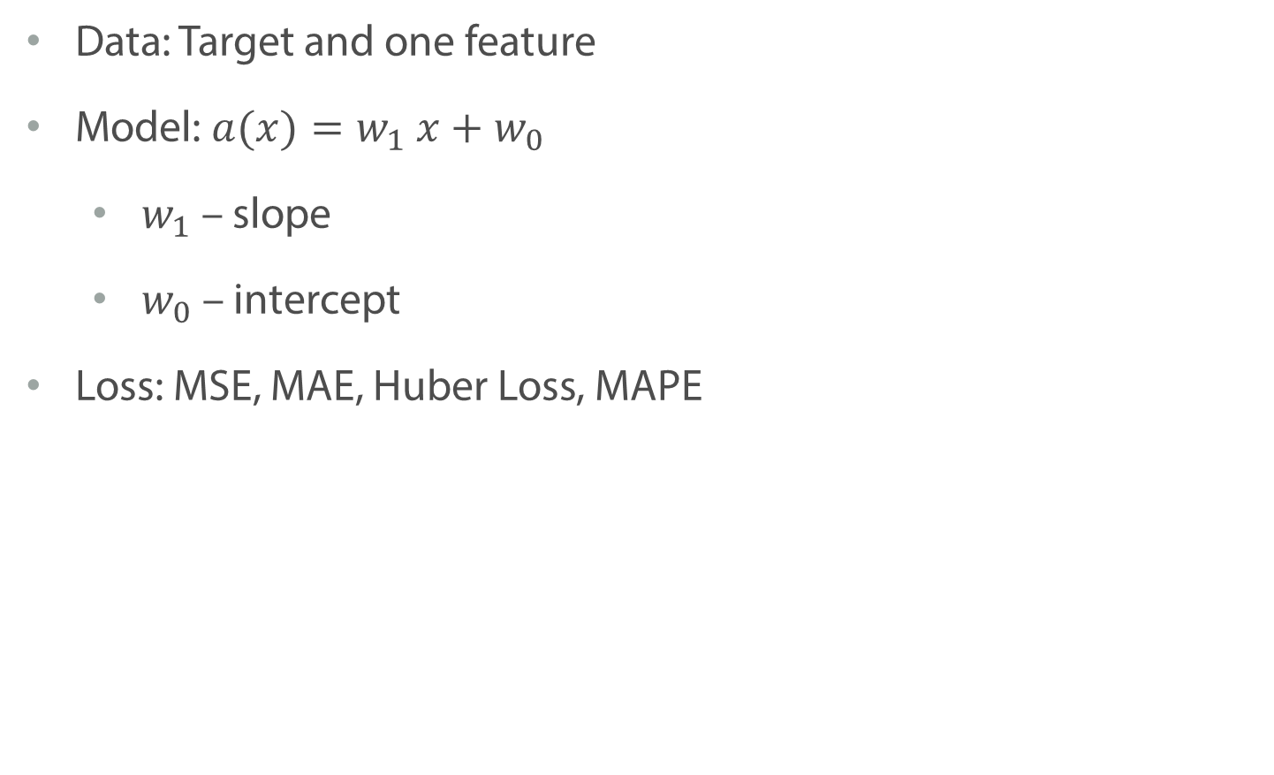
Simple linear regression
Data: Target and one feature
Model: $a(x)=w_{1} x+w_{0}$
$w_{1}$ – slope
$w_{0}$ – intercept
Loss: MSE, MAE, Huber Loss, MAPE

Slide 48
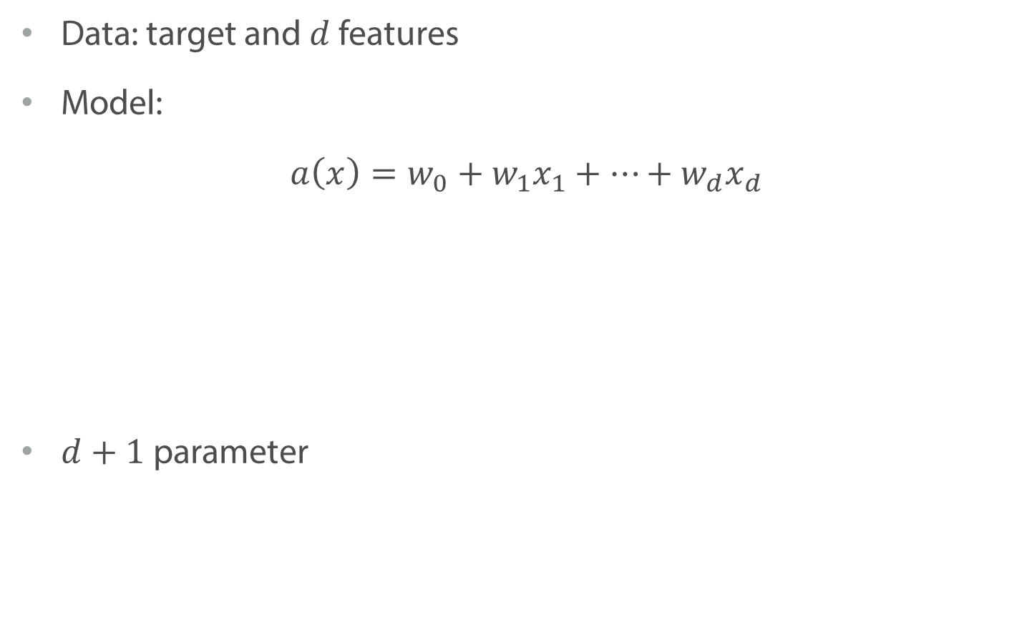
Linear regression with multiple variables
Data: target and $d$ features
Model:
$$a\left(x\right)=w_{0}+w_{1}x_{1}+…+w_{d}x_{d}$$
$d+1$ parameter

Slide 49
Linear regression with multiple variables
Data: target and $d$ features
Model:
$$a\left(x\right)=w_{0}+w_{1}x_{1}+…+w_{d}x_{d}$$
$d+1$ parameter
Bias/ intercept
Weights/ coefficients

Slide 50
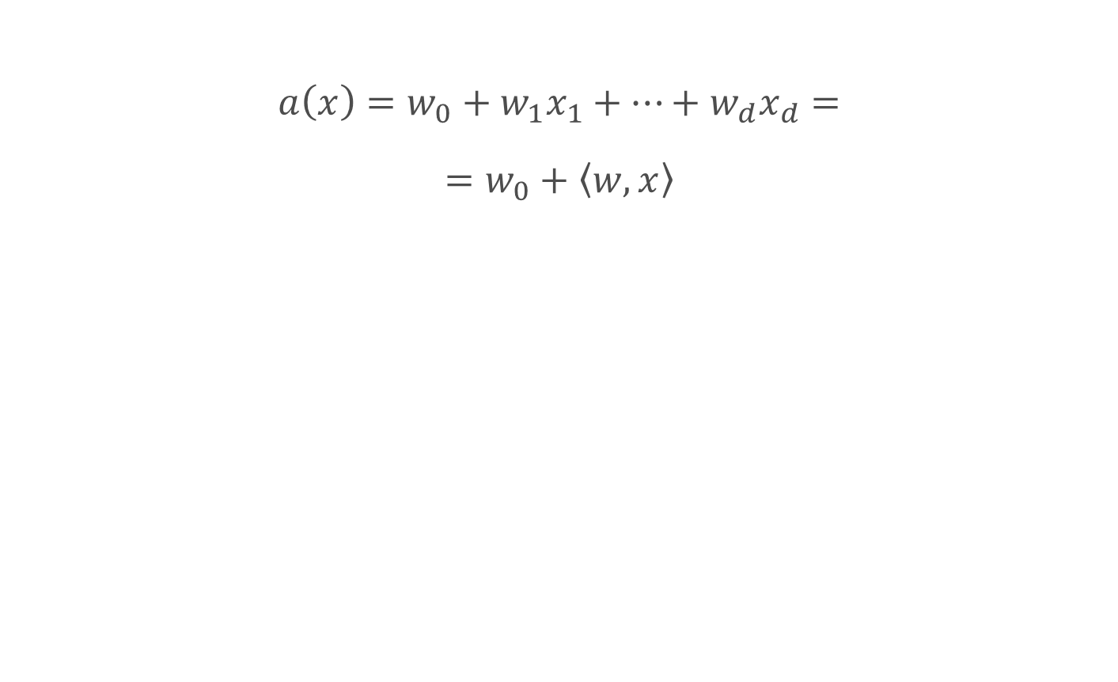
Linear regression
$$a\left(x\right)=w_{0}+w_{1}x_{1}+…+w_{d}x_{d}=$$
$$=w_{0}+\left\langle w,x\right\rangle$$

Slide 51
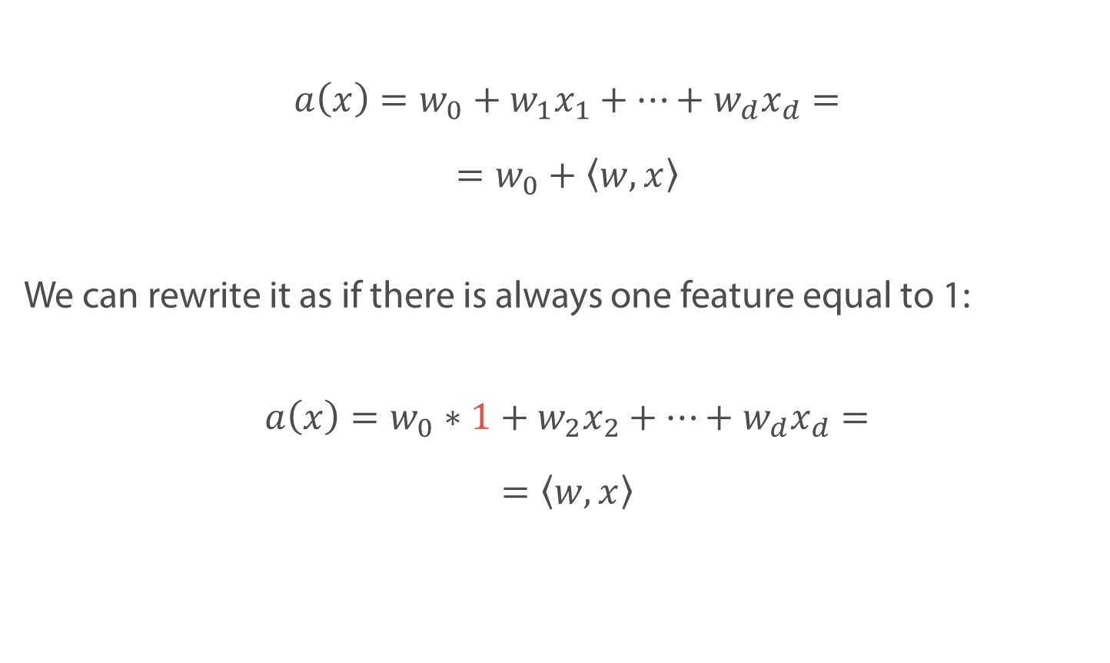
Linear regression
$$a\left(x\right)=w_{0}+w_{1}x_{1}+…+w_{d}x_{d}=$$
$$=w_{0}+\left\langle w,x\right\rangle$$
We can rewrite it as if there is always one feature equal to 1:
$$a\left(x\right)=w_{0}∗1+w_{2}x_{2}+…+w_{d}x_{d}=$$
$$=\left\langle w,x\right\rangle$$

Slide 52
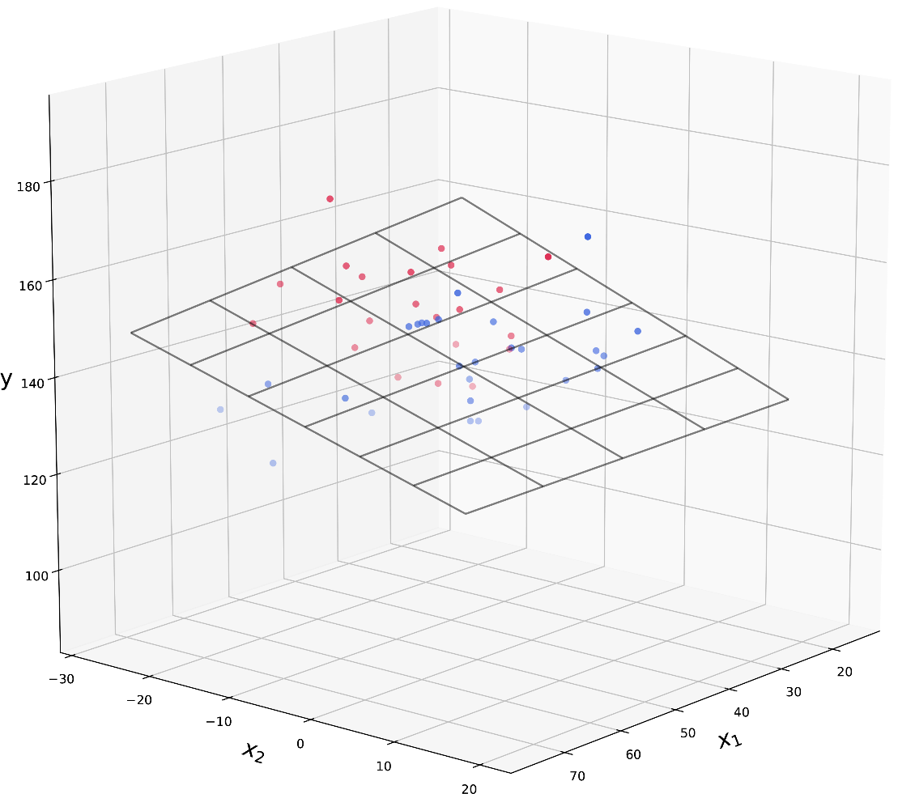
Linear regression

Slide 53
Linear algebra recap

Slide 54
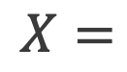
Matrices
Matrix with objects and features
$$X=$$

Slide 55
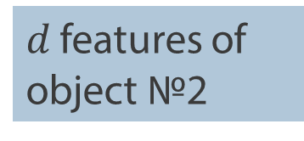
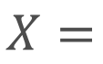
Matrices
Matrix with objects and features
$d$ features of object №2
$$X=$$

Slide 56
Matrices
Matrix with objects and features
Second feature for all objects
$$X=$$

Slide 57
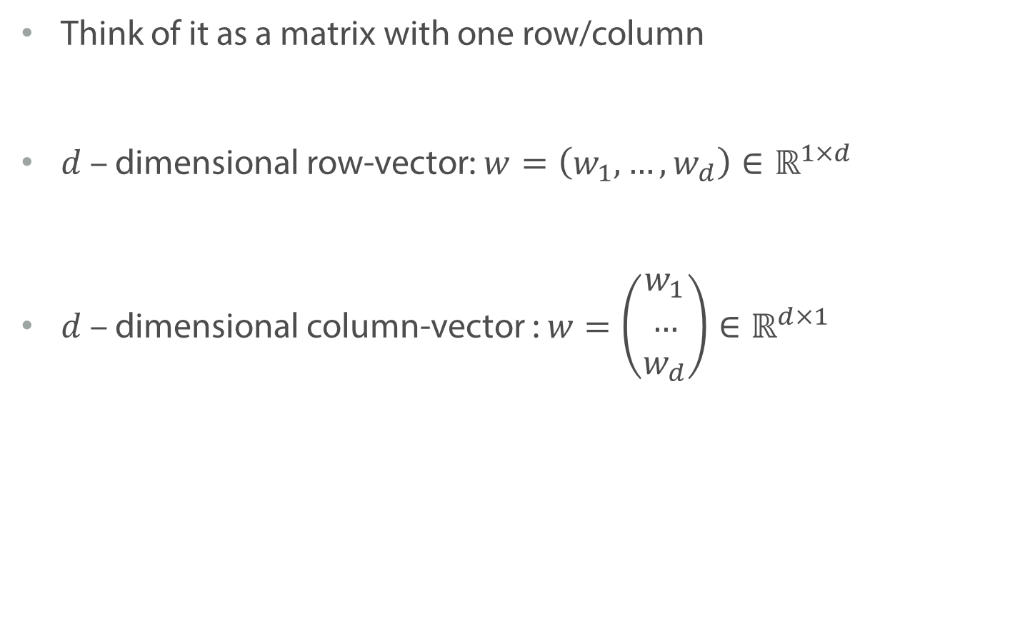
Vectors
Think of it as a matrix with one row/column
$d$ – dimensional row-vector: $w=\left(w_{1},…, w_{d}\right)∈ℝ^{1×d}$
$d$ – dimensional column-vector : $w=\left(\begin{matrix}w_{1} \\ … \\ w_{d}\end{matrix}\right)∈ℝ^{d×1}$

Slide 58
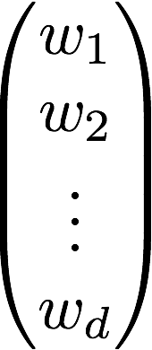
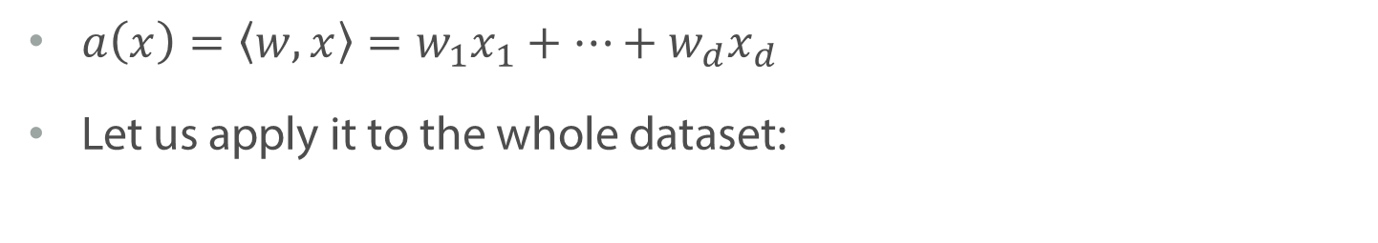
Linear model: matrix multiplication
$a\left(x\right)=\left\langle w,x\right\rangle =w_{1}x_{1}+…+w_{d}x_{d}$
Let us apply it to the whole dataset:
?

Slide 59
Linear model: matrix multiplication
$a\left(x\right)=\left\langle w,x\right\rangle =w_{1}x_{1}+…+w_{d}x_{d}$
Let us apply it to the whole dataset:

Slide 60
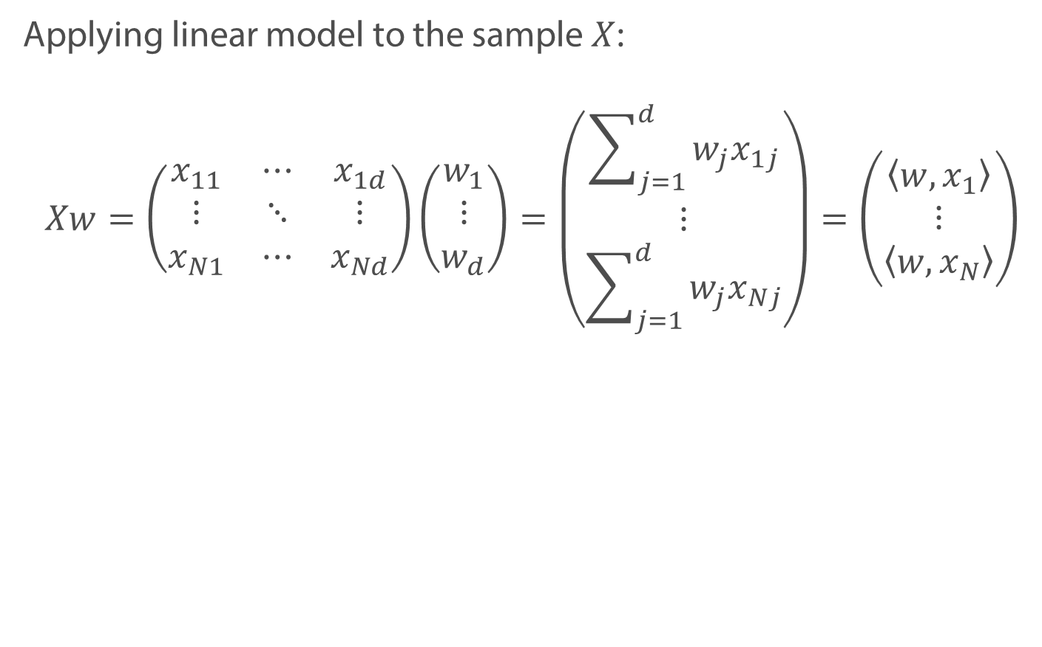
Linear model: matrix form
Applying linear model to the sample $X$:
$$Xw=\left(\begin{matrix}x_{11} & ⋯ & x_{1d} \\ ⋮ & ⋱ & ⋮ \\ x_{N1} & ⋯ & x_{Nd}\end{matrix}\right)\left(\begin{matrix}w_{1} \\ ⋮ \\ w_{d}\end{matrix}\right)=\left(\begin{matrix}\sum_{j=1}^{d}{w_{j}x_{1j}} \\ ⋮ \\ \sum_{j=1}^{d}{w_{j}x_{Nj}}\end{matrix}\right)=\left(\begin{matrix}\left\langle w,x_{1}\right\rangle \\ ⋮ \\ \left\langle w,x_{N}\right\rangle \end{matrix}\right)$$

Slide 61
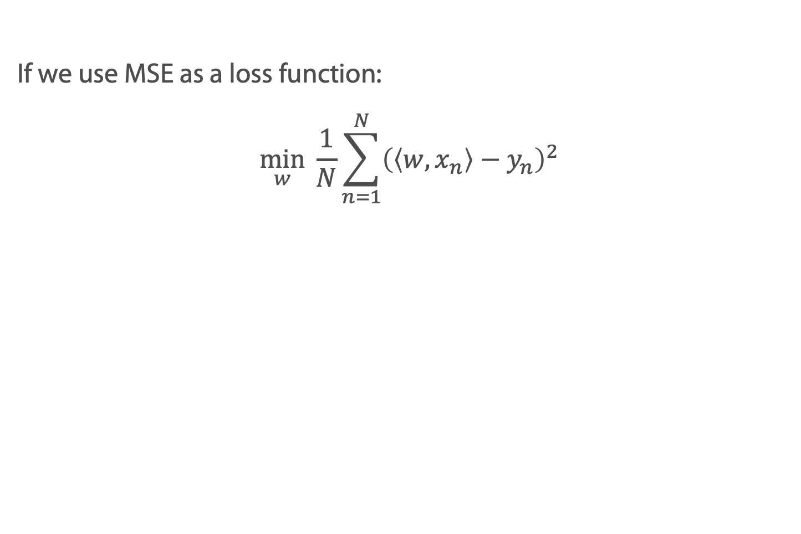
Mean Squared Error
If we use MSE as a loss function:
$$\min_{w} \frac{1}{N}\sum_{n=1}^{N}{{\left(\left\langle w,x_{n}\right\rangle −y_{n}\right)}^{2}}$$

Slide 62
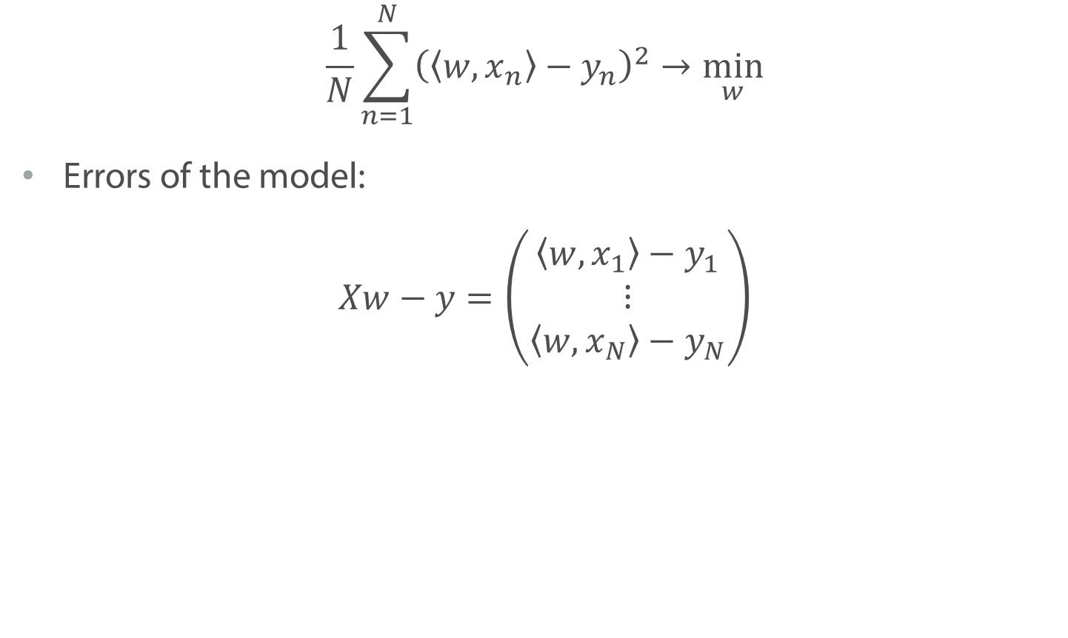
Mean Squared Error
$$\frac{1}{N}\sum_{n=1}^{N}{{\left(\left\langle w,x_{n}\right\rangle −y_{n}\right)}^{2}}→\min_{w}$$
Errors of the model:
$$Xw−y=\left(\begin{matrix}\left\langle w,x_{1}\right\rangle −y_{1} \\ ⋮ \\ \left\langle w,x_{N}\right\rangle −y_{N}\end{matrix}\right)$$

Slide 63
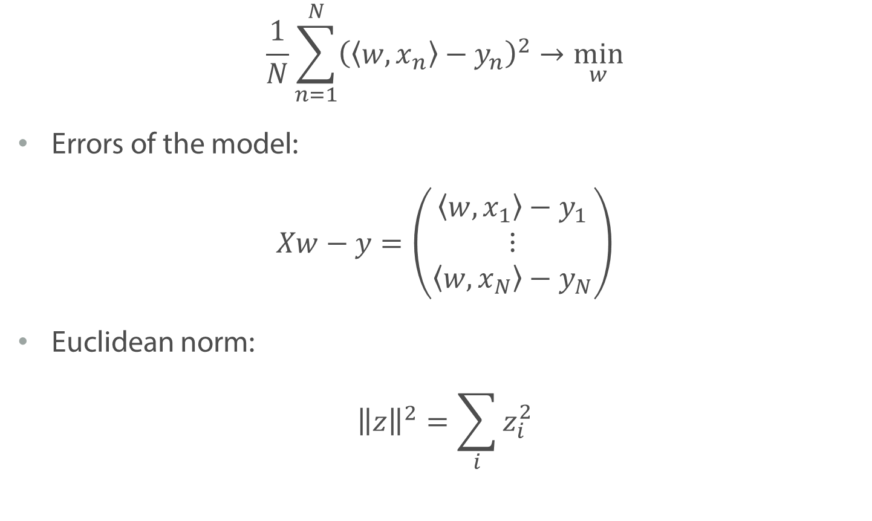
Mean Squared Error
$$\frac{1}{N}\sum_{n=1}^{N}{{\left(\left\langle w,x_{n}\right\rangle −y_{n}\right)}^{2}}→\min_{w}$$
Errors of the model:
$$Xw−y=\left(\begin{matrix}\left\langle w,x_{1}\right\rangle −y_{1} \\ ⋮ \\ \left\langle w,x_{N}\right\rangle −y_{N}\end{matrix}\right)$$
Euclidean norm:
$${\left\|z\right\|}^{2}=\sum_{i}{z_{i}^{2}}$$

Slide 64
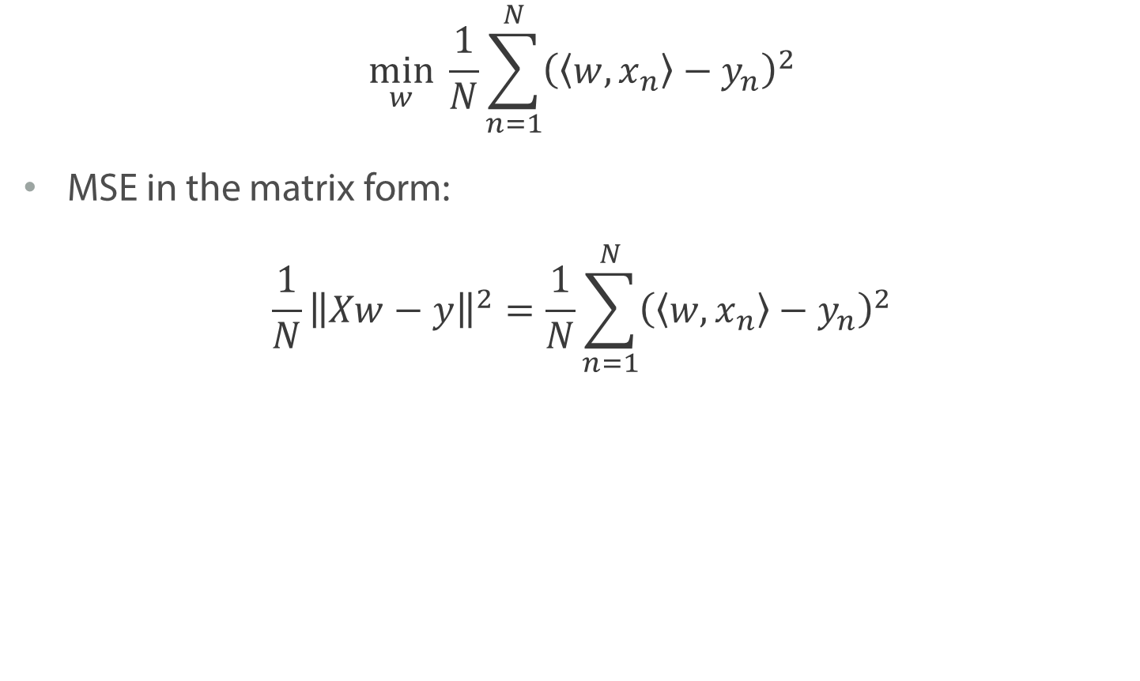
Mean Squared Error
$$\min_{w} \frac{1}{N}\sum_{n=1}^{N}{{\left(\left\langle w,x_{n}\right\rangle −y_{n}\right)}^{2}}$$
MSE in the matrix form:
$$\frac{1}{N}{\left\|Xw−y\right\|}^{2}=\frac{1}{N}\sum_{n=1}^{N}{{\left(\left\langle w,x_{n}\right\rangle −y_{n}\right)}^{2}}$$

Slide 65
Summary
We can use linear algebra to represent linear regression
It will help us to work faster even for large datasets

Slide 66
Multivariate linear regression

Slide 67
Losses in regression task

Slide 68
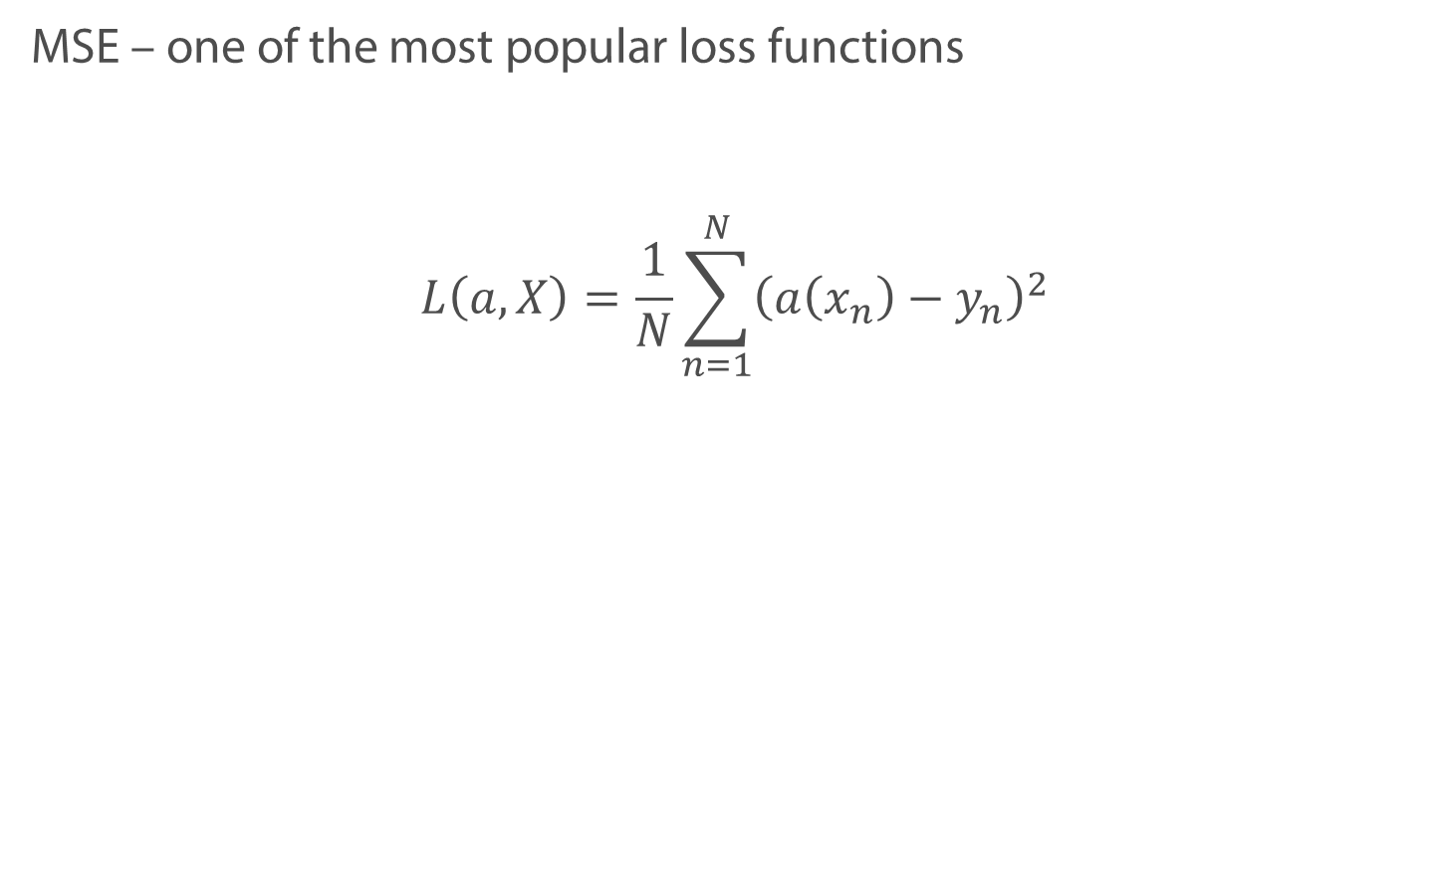
Mean Squared Error
MSE – one of the most popular loss functions
$$L\left(a, X\right)=\frac{1}{N}\sum_{n=1}^{N}{{\left(a\left(x_{n}\right)−y_{n}\right)}^{2}}$$

Slide 69
Outliers and MSE
With outlier
Without outlier

Slide 70
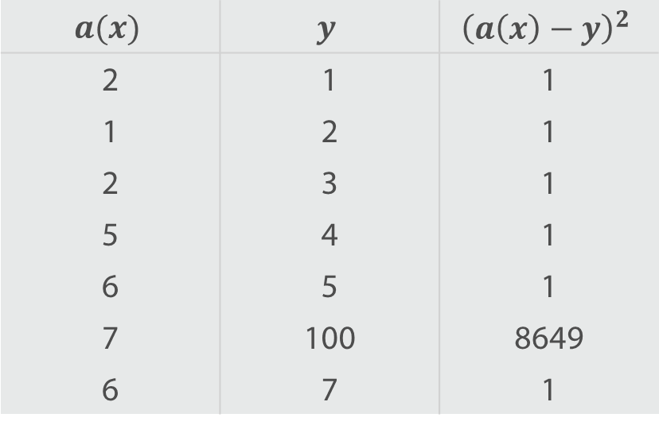
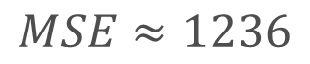
Outliers and MSE
$$a(x)$$ | $$y$$ | $${\left(a\left(x\right)−y\right)}^{2}$$
2 | 1 | 1
1 | 2 | 1
2 | 3 | 1
5 | 4 | 1
6 | 5 | 1
7 | 100 | 8649
6 | 7 | 1
$$MSE≈1236$$

Slide 71
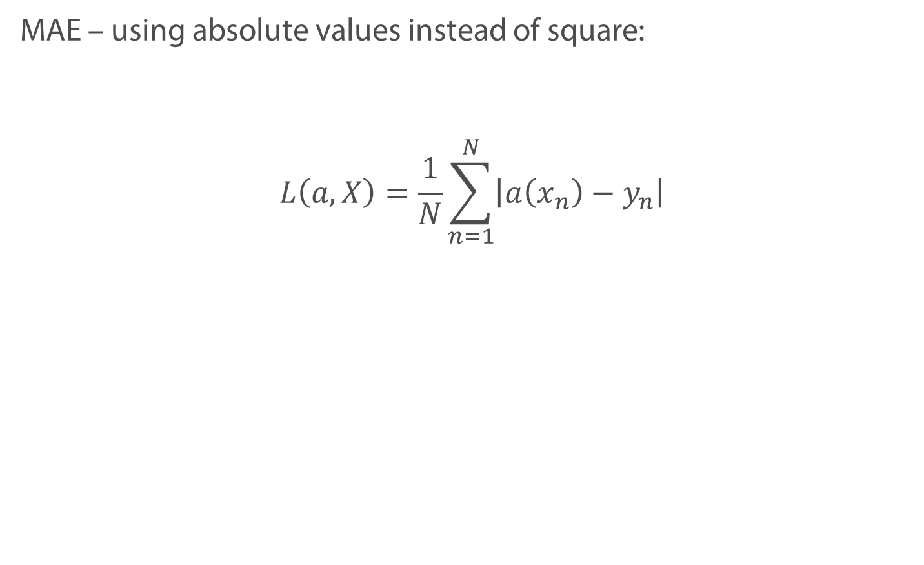
Mean Absolute Error
MAE – using absolute values instead of square:
$$L\left(a, X\right)=\frac{1}{N}\sum_{n=1}^{N}{\left|a\left(x_{n}\right)−y_{n}\right|}$$

Slide 72
Outliers and MAE
Training with MSE
Training with MAE

Slide 73
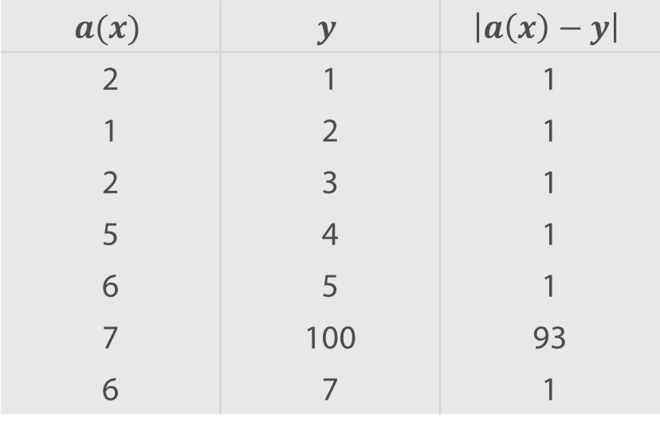
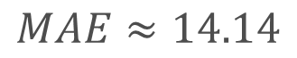
Outliers and MAE
$$a(x)$$ | $$y$$ | $$\left|a\left(x\right)−y\right|$$
2 | 1 | 1
1 | 2 | 1
2 | 3 | 1
5 | 4 | 1
6 | 5 | 1
7 | 100 | 93
6 | 7 | 1
$$MAE≈14.14$$

Slide 74
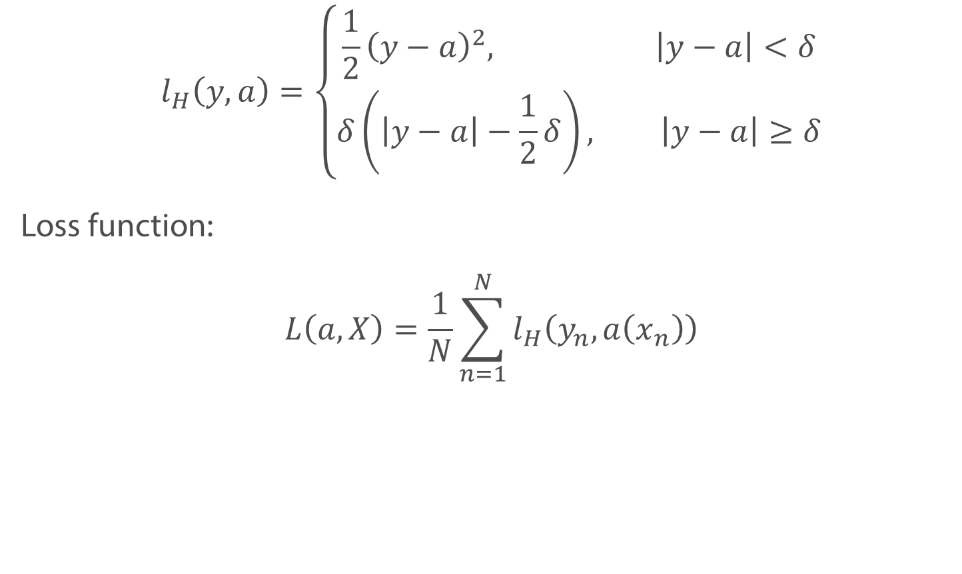
Huber Loss
$$l_{H}\left(y, a\right)=\left\{\begin{aligned}\frac{1}{2}{\left(y−a\right)}^{2}, \left|y−a\right|<δ \\ δ\left(\left|y−a\right|−\frac{1}{2}δ\right), \left|y−a\right|≥δ\end{aligned}\right.$$
Loss function:
$$L\left(a, X\right)=\frac{1}{N}\sum_{n=1}^{N}{l_{H}\left(y_{n}, a\left(x_{n}\right)\right)}$$

Slide 75

Huber Loss
$$l_{H}\left(y, a\right)=\left\{\begin{aligned}\frac{1}{2}{\left(y−a\right)}^{2}, \left|y−a\right|<δ \\ δ\left(\left|y−a\right|−\frac{1}{2}δ\right), \left|y−a\right|≥δ\end{aligned}\right.$$

Slide 76

Mean Absolute Percentage Error
MAPE – loss similar to MAE
$$L\left(a, X\right)=\frac{100\%}{N}\sum_{n=1}^{N}{\left|\frac{a\left(x_{n}\right)−y_{n}}{y_{n}}\right|}$$

Slide 77
Mean Absolute Percentage Error
Non-symmetric function
Give preference to negative error

Slide 78

Symmetric MAPE
SMAPE – add some symmetry
$$L\left(a, X\right)=\frac{100\%}{N}\sum_{n=1}^{N}{\frac{\left|y_{n}−a\left(x_{n}\right)\right|}{(\left|y_{n}\right|+\left|a\left(x_{n}\right)\right|)/2}}$$

Slide 79
Symmetric MAPE
SMAPE – add some symmetry
$$L\left(a, X\right)=\frac{100\%}{N}\sum_{n=1}^{N}{\frac{\left|y_{n}−a\left(x_{n}\right)\right|}{(\left|y_{n}\right|+\left|a\left(x_{n}\right)\right|)/2}}$$

Slide 80
Summary
The resulting model strongly depends on the loss
MAE and Huber loss are less sensitive to outliers
MAPE is a non-symmetric loss

Slide 81
Interpretation and feature importance

Slide 82
Prediction of an apartment price
$$a\left(x\right)=100.000∗\left(area\right)$$
$$+ 500.000∗\left(number of stores nearby\right)$$
$$+ 100∗(average income of households)$$

Slide 83
Prediction of an apartment price
$$a\left(x\right)=100.000∗\left(area\right)$$
$$+ 500.000∗\left(number of stores nearby\right)$$
$$+ 100∗(average income of households)$$
Does the higher weight mean that the feature is more important?

Slide 84
Prediction of an apartment price
$$a\left(x\right)=100.000∗\left(area, sq.m.\right)$$
$$+ 500.000∗\left(number of stores nearby\right)$$
$$+ 100∗(average income of households)$$
Does the higher weight mean that the feature is more important?

Slide 85
Prediction of an apartment price
$$a\left(x\right)=10∗\left(area, sq.cm.\right)$$
$$+ 500.000∗\left(number of stores nearby\right)$$
$$+ 100∗(average income of households)$$
Does the higher weight mean that the feature is more important?

Slide 86
Prediction of an apartment price
$$a\left(x\right)=10∗\left(area, sq.cm.\right)$$
$$+ 500.000∗\left(number of stores nearby\right)$$
$$+ 100∗(average income of households)$$
Does the higher weight mean that the feature is more important?
Only if all features are scaled!

Slide 87


Feature importance
$$a\left(x\right)= x_{1}+2x_{2}$$
$$x_{1}$$ | $$x_{2}$$
0.31 | 1
0.81 | 1
0.09 | 1
0.14 | 0
0.78 | 0
0.29 | 0
0.11 | 0
0.43 | 0
… | …

Slide 88



Feature importance
$$a\left(x\right)= x_{1}+2x_{2}$$
$$x_{1}$$ | $$x_{2}$$
0.31 | 1
0.81 | 1
0.09 | 1
0.14 | 0
… | …
Remove the first feature $a\left(x\right)={wx}_{2}$ $MSE≈0.08$

Slide 89


Feature importance
$$y=x_{1}+2x_{2}$$
$$x_{1}$$ | $$x_{2}$$
0.31 | 1
0.81 | 1
0.09 | 1
0.14 | 0
… | …
Remove the first feature $a\left(x\right)={wx}_{2}$ $MSE≈0.08$
Remove the second feature $a\left(x\right)={wx}_{1}$ $MSE≈0.04$

Slide 90
Summary
It is worth comparing the weights only if features are scaled
Estimate importance of a feature by removing it from the model

